Slide 1

Cross Platform Mobile and Web Apps Development
Day 4

Slide 2
Exercise
Review and implement the Cordova tutorial at http://ccoenraets.github.io/cordova-tutorial/index.html
Create the Cordova Project
Build a Cordova Project
Set up the Workshop Files
Choose a Data Storage Strategy
Use Native Notification
Avoid the Click Delay
Set up a Single Page App
Use a Template
Create View Classes
Implement View Routing
Use Hardware Acceleration
Optional:
Use Location API
Use Contacts API
Use Camera API

Slide 3
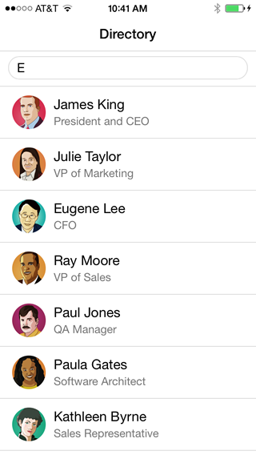
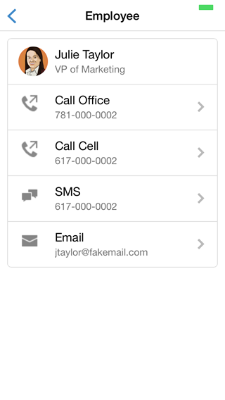
Exercise
UI Designs for the Employees App:

Slide 4
Student Project Presentation
Present your Cordova project to the class.
What issues you have encountered, and how have you resolved them?
Where have you deviated from the tutorial instructions and why?

